Slide 1
Chapter 7:
Modeling Network Components

Slide 2
Overview of this chapter
Previous chapter: load and generation are at the same location
However, in most power systems, they are connected by vast networks
This chapter: develop models of the network components
Lines
Transformers
Substations (locations where components connect)
Next chapter: combine these models into an overall network model

Slide 3
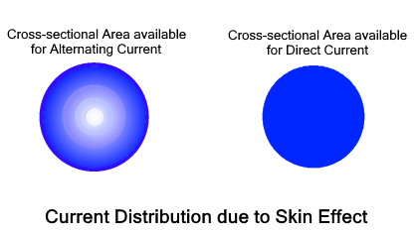
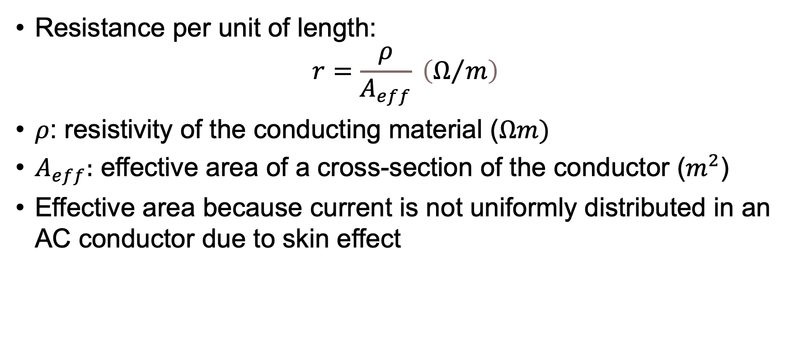
Model of a unit of length of AC line
Resistance per unit of length:
$$r=\frac{ρ}{A_{eff}} \left(Ω/m\right)$$
$ρ$: resistivity of the conducting material ($Ωm)$
$A_{eff}:$ effective area of a cross-section of the conductor ($m^{2}$)
Effective area because current is not uniformly distributed in an AC conductor due to skin effect

Slide 4
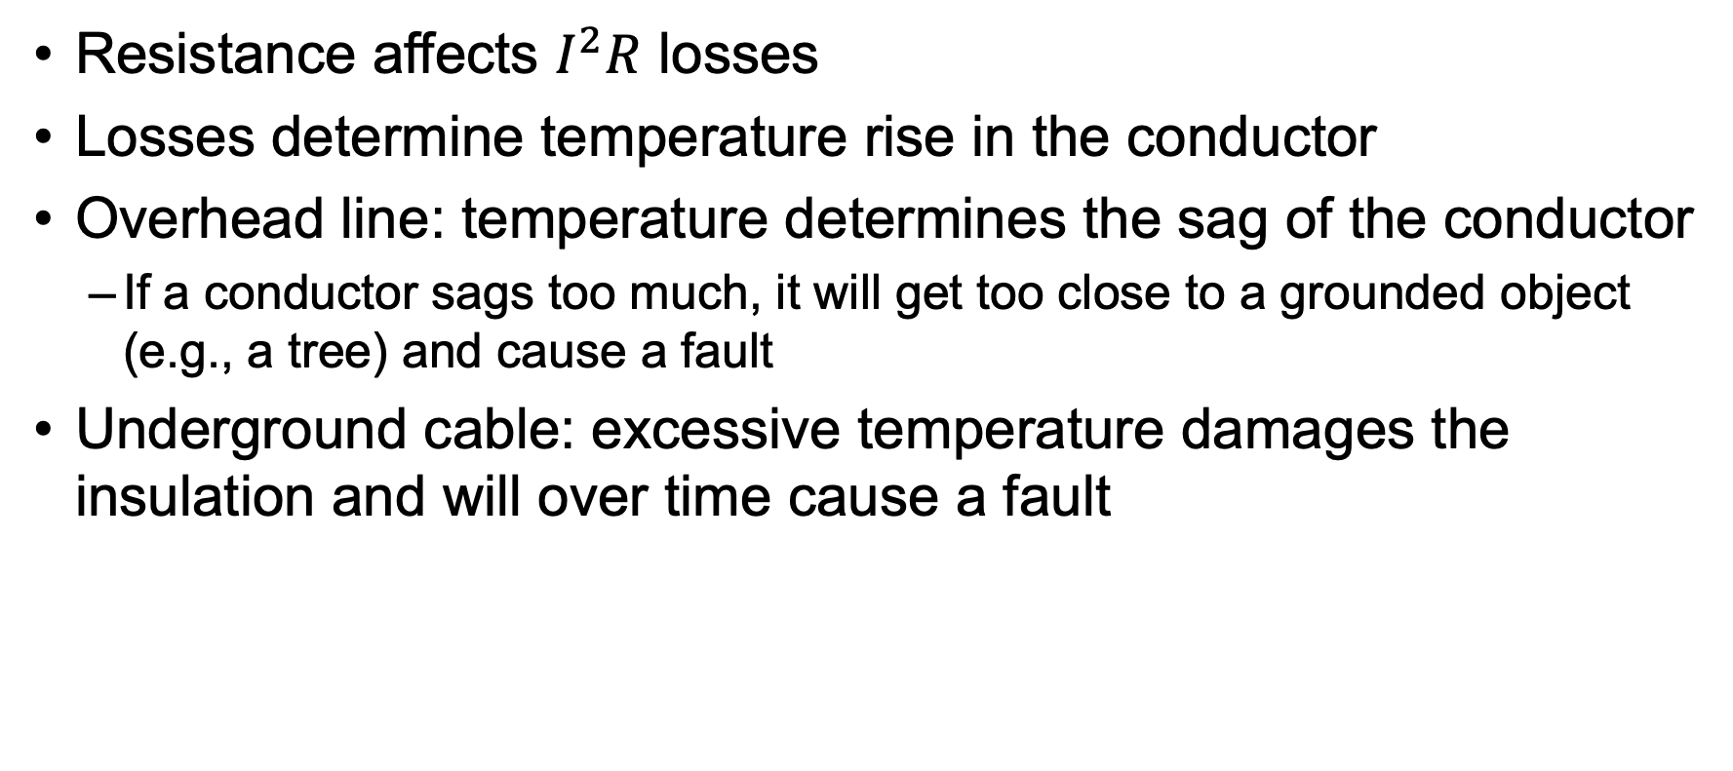
Why is knowing the resistance of a line important?
Resistance affects $I^{2}R$ losses
Losses determine temperature rise in the conductor
Overhead line: temperature determines the sag of the conductor
If a conductor sags too much, it will get too close to a grounded object (e.g., a tree) and cause a fault
Underground cable: excessive temperature damages the insulation and will over time cause a fault

Slide 5
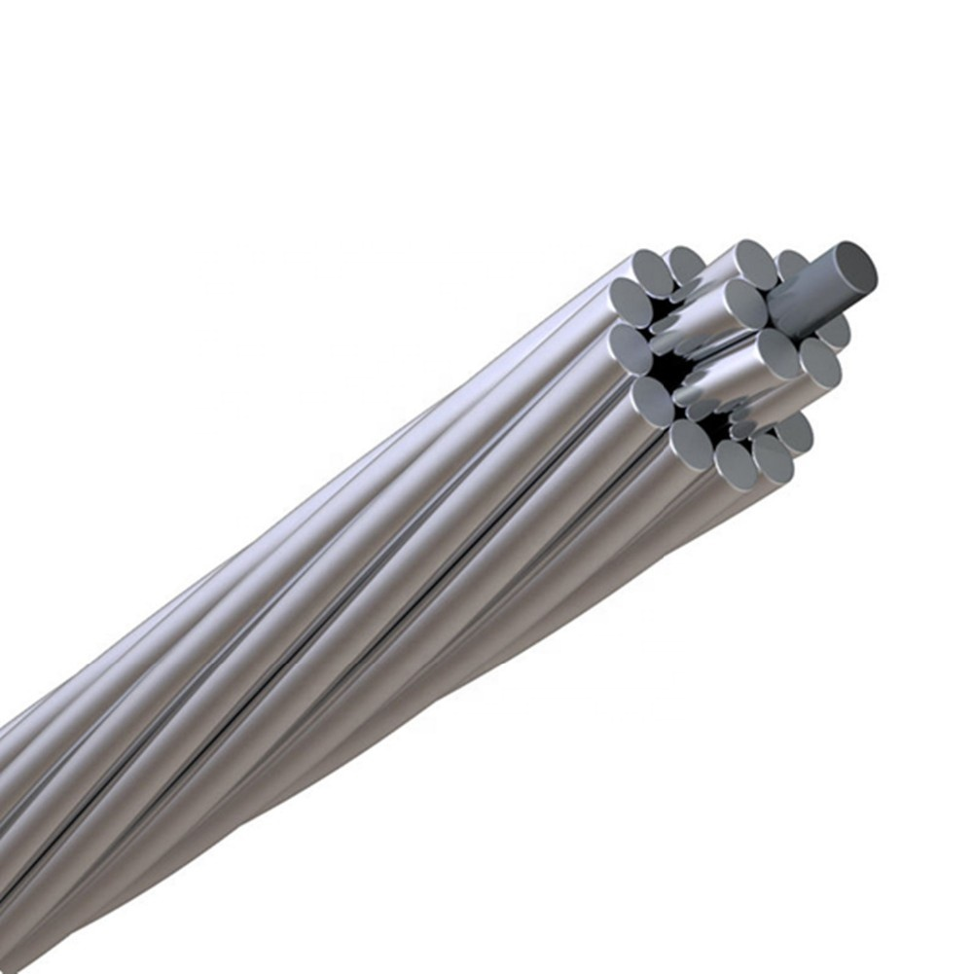
Aluminum Conductor Steel Reinforced (ACSR)
Common type of conductor used for overhead transmission and distribution lines
Outer aluminum strands support conduction
Inner steel strands provide tensile strength and reduce sagging
Many different sizes and configuration of strands, each with its own bird name.

Slide 6
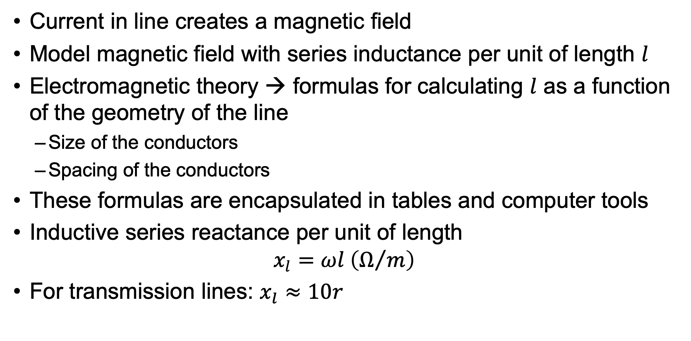
Magnetic field
Current in line creates a magnetic field
Model magnetic field with series inductance per unit of length $l$
Electromagnetic theory → formulas for calculating $l$ as a function of the geometry of the line
Size of the conductors
Spacing of the conductors
These formulas are encapsulated in tables and computer tools
Inductive series reactance per unit of length
$$x_{l}=ωl \left(Ω/m\right)$$
For transmission lines: $x_{l}≈10r$

Slide 7
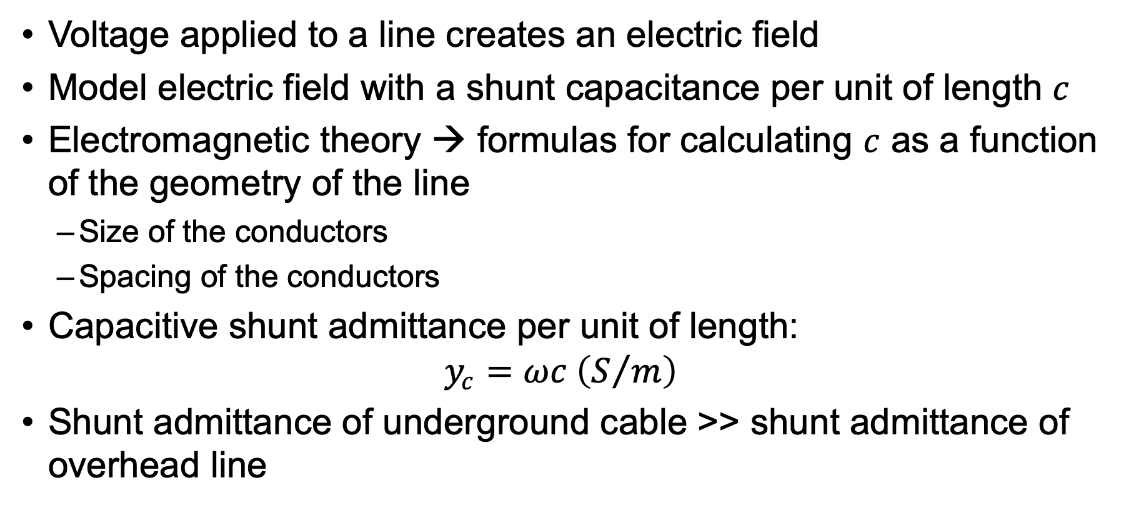
Electric field
Voltage applied to a line creates an electric field
Model electric field with a shunt capacitance per unit of length $c$
Electromagnetic theory → formulas for calculating $c$ as a function of the geometry of the line
Size of the conductors
Spacing of the conductors
Capacitive shunt admittance per unit of length:
$$y_{c}=ωc \left(S/m\right)$$
Shunt admittance of underground cable >> shunt admittance of overhead line

Slide 8
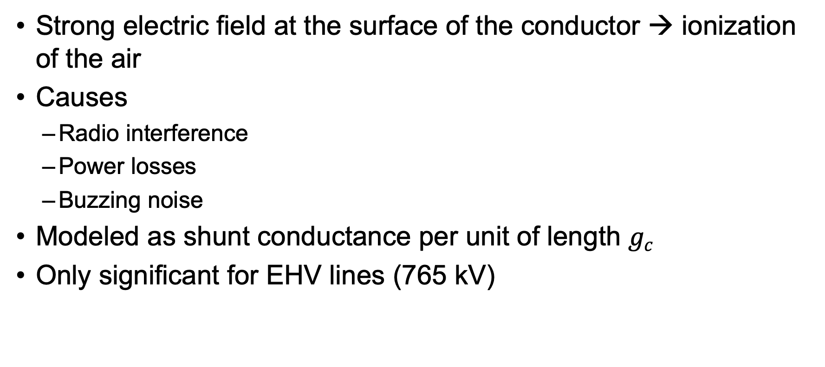
Corona effect
Strong electric field at the surface of the conductor → ionization of the air
Causes
Radio interference
Power losses
Buzzing noise
Modeled as shunt conductance per unit of length $g_{c}$
Only significant for EHV lines (765 kV)

Slide 9
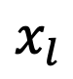
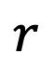
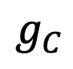
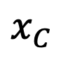
Model of a unit length of line
$$r$$
$$x_{l}$$
$$g_{C}$$
$$x_{C}$$

Slide 10
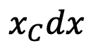
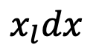
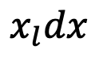
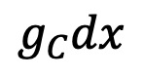
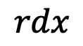
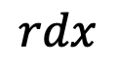
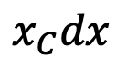
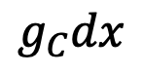
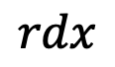
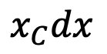
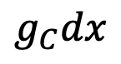
Rigorous model of a line
$$rdx$$
$$x_{l}dx$$
$$rdx$$
$$x_{l}dx$$
$$rdx$$
$$x_{l}dx$$
$$g_{C}dx$$
$$x_{C}dx$$
$$g_{C}dx$$
$$x_{C}dx$$
$$g_{C}dx$$
$$x_{C}dx$$
Useful for studying wave propagation along the line

Slide 11
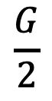
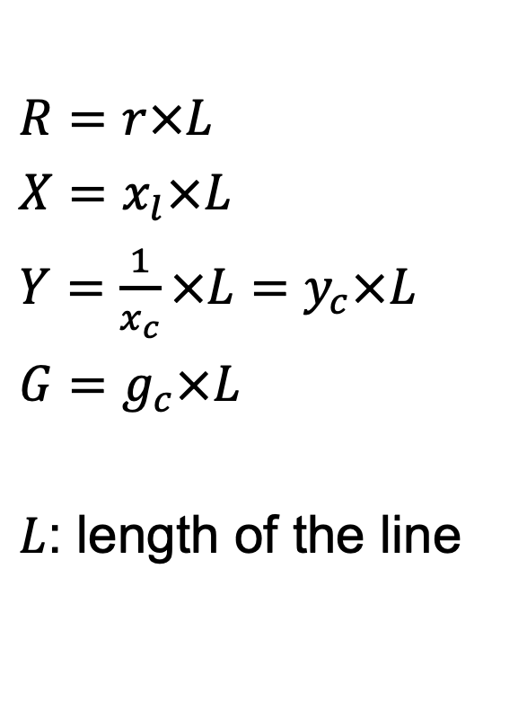
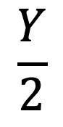
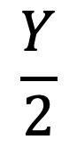
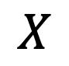
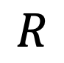
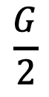
$π$model of a medium length line ($L$< 300 km)
$R=r×L$
$X=x_{l}×L$
$Y=\frac{1}{x_{c}}×L=y_{c}×L$
$G=g_{c}×L$
$L$: length of the line
$$R$$
$$X$$
$$\frac{Y}{2}$$
$$\frac{Y}{2}$$
$$\frac{G}{2}$$
$$\frac{G}{2}$$

Slide 12
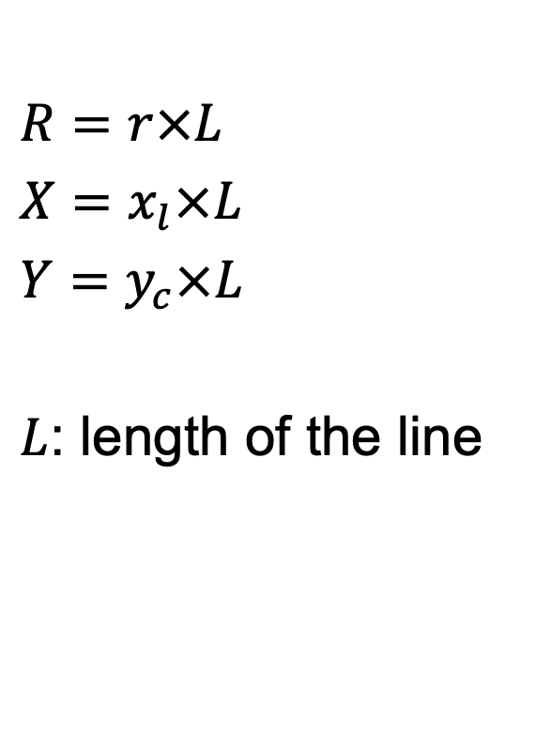
$π$model of a line neglecting corona losses
$R=r×L$
$X=x_{l}×L$
$Y=y_{c}×L$
$L$: length of the line
$$R$$
$$X$$
$$\frac{Y}{2}$$
$$\frac{Y}{2}$$

Slide 13
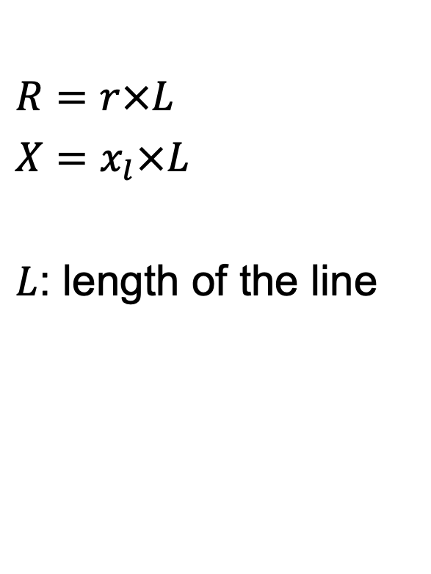
Model of a short overhead line ($L$< 25 km)
$R=r×L$
$X=x_{l}×L$
$L$: length of the line
$$R$$
$$X$$

Slide 14
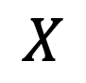
Model that we will use when we want to keep things simple…
$$X$$

Slide 15
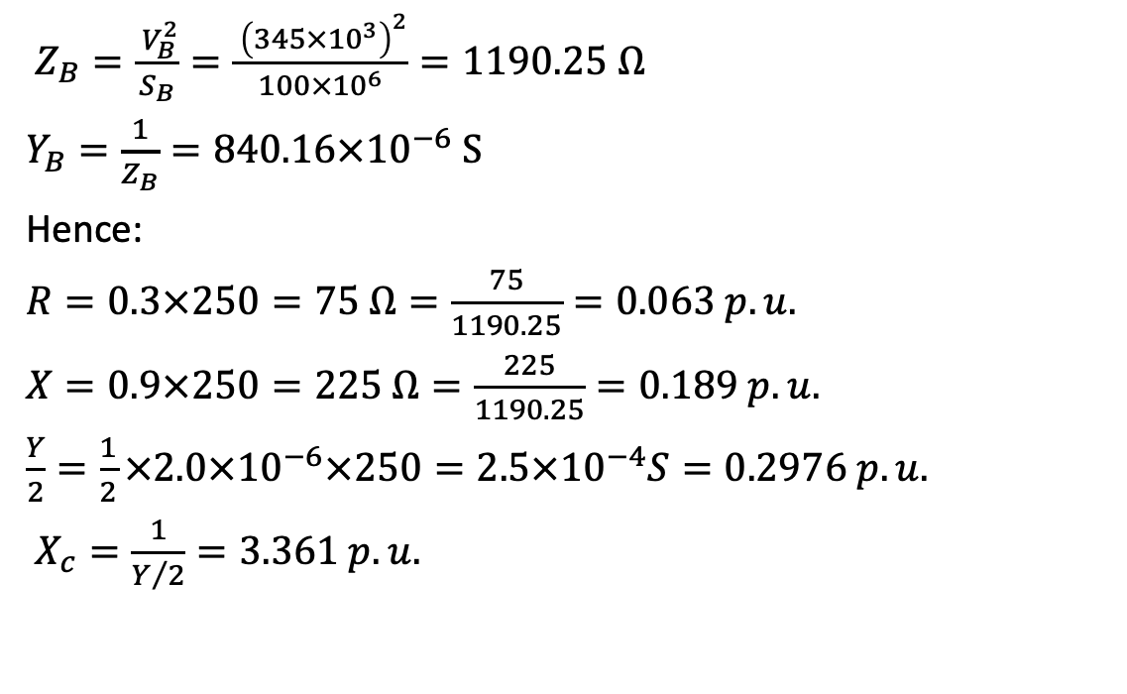
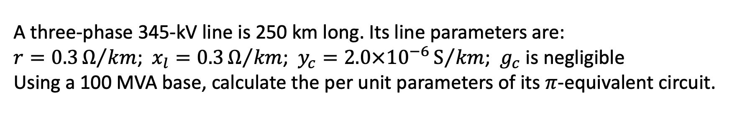
Example 7.1
A three-phase 345-kV line is 250 km long. Its line parameters are:
$r=0.3Ω/{km}$; $x_{l}=0.3Ω/{km}$; $y_{c}=2.0×{10}^{−6}S/{km}$; $g_{c}$ is negligible
Using a 100 MVA base, calculate the per unit parameters of its $π$-equivalent circuit.
$Z_{B}=\frac{ V_{B}^{2}}{S_{B}}=\frac{ {\left(345×{10}^{3}\right)}^{2}}{100×{10}^{6}}=1190.25 Ω$
$Y_{B}=\frac{1}{Z_{B}}=840.16×{10}^{−6} S$
Hence:
$R=0.3×250=75 Ω=\frac{75}{1190.25}=0.063 p.u.$
$X=0.9×250=225 Ω=\frac{225}{1190.25}=0.189 p.u.$
$\frac{Y}{2}=\frac{1}{2}×2.0×{10}^{−6}×250=2.5×{10}^{−4}S=0.2976 p.u.$
$X_{c}=\frac{1}{Y/2}=3.361 p.u.$

Slide 16
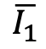
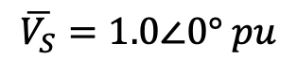
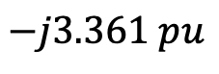
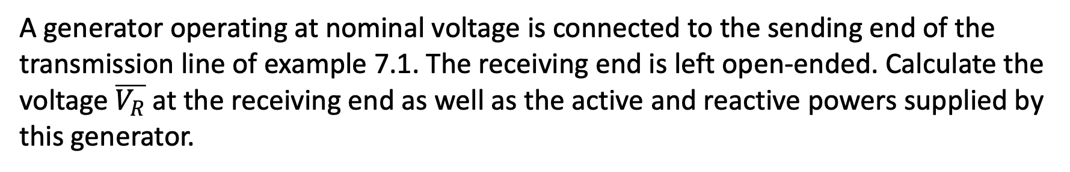
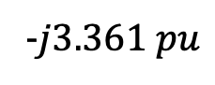
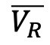
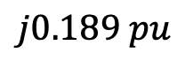
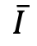
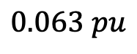
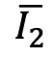
Example 7.2
A generator operating at nominal voltage is connected to the sending end of the transmission line of example 7.1. The receiving end is left open-ended. Calculate the voltage $\overline{V_{R}}$ at the receiving end as well as the active and reactive powers supplied by this generator.
$$\overline{I}$$
$$0.063 pu$$
$$j0.189 pu$$
$$\overline{I_{2}}$$
$$\overline{I_{1}}$$
$$\overline{V_{S}}=1.0∠0° pu$$
-$j3.361 pu$
$$−j3.361 pu$$
$$\overline{V_{R}}$$

Slide 17
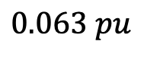
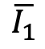
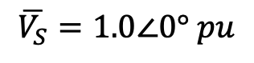
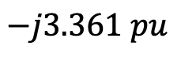
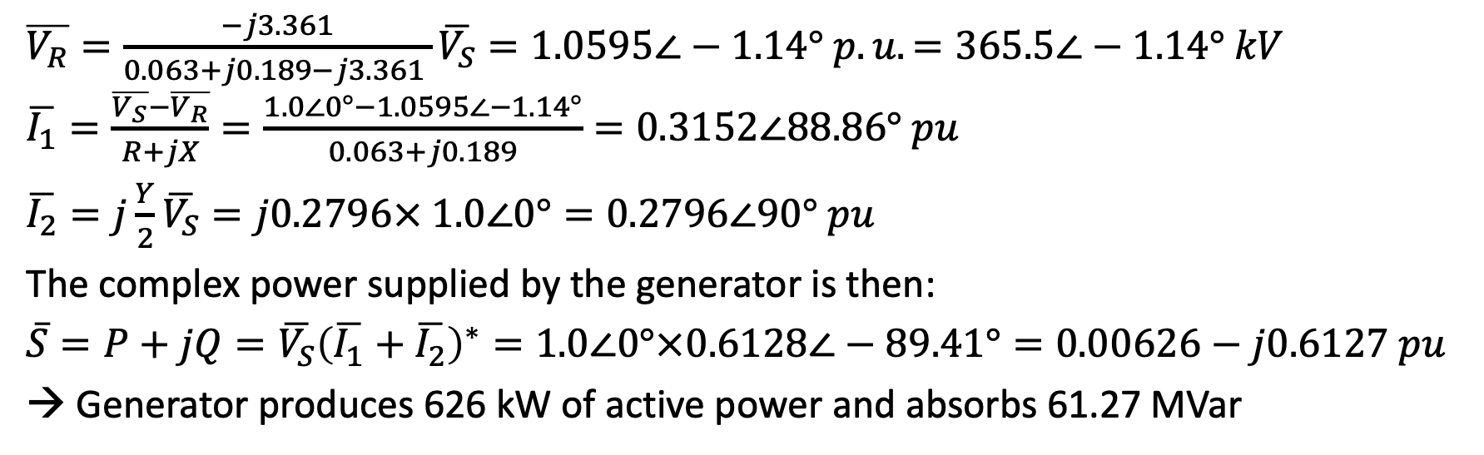
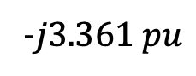


Example 7.2
$$\overline{I}$$
$$0.063 pu$$
$$j0.189 pu$$
$$\overline{I_{2}}$$
$$\overline{I_{1}}$$
$$\overline{V_{S}}=1.0∠0° pu$$
-$j3.361 pu$
$$−j3.361 pu$$
$$\overline{V_{R}}$$
$\overline{V_{R}}=\frac{−j3.361}{0.063+j0.189−j3.361 }\overline{V_{S}}=1.0595∠−1.14° p.u.=365.5∠−1.14° kV$
$\overline{I_{1}}=\frac{\overline{V_{S}}−\overline{V_{R}}}{R+jX}=\frac{1.0∠0°−1.0595∠−1.14°}{0.063+j0.189}=0.3152∠88.86° pu$
$\overline{I_{2}}=j\frac{Y}{2}\overline{V_{S}}=j0.2796× 1.0∠0°=0.2796∠90° pu$
The complex power supplied by the generator is then:
$\overline{S}=P+jQ=\overline{V_{S}}{\left(\overline{I_{1}}+\overline{I_{2}}\right)}^{∗}=1.0∠0°×0.6128∠−89.41°=0.00626−j0.6127 pu$
→ Generator produces 626 kW of active power and absorbs 61.27 MVar

Slide 18














Example 7.3
A load of 125 MW at 0.85 p.f. lagging is connected at the receiving end of the line of Example 7.1. If the receiving end voltage $\overline{V_{R}}=1.0∠0° p.u.$, what is the voltage $\overline{V_{S}}$ at the sending end? How much active and reactive power does the generator produce?
$P_{L}=\frac{125}{100}=1.25 pu$
$Q_{L}=\frac{125×tan⁡(\arccos{(0.85)})}{100}=0.775 pu$
$R_{L}=\frac{V_{R}^{2}}{P_{L}}=\frac{{\left(1.0\right)}^{2}}{1.25}=0.8 pu$
$X_{L}=\frac{V_{R}^{2}}{Q_{L}}=\frac{{\left(1.0\right)}^{2}}{0.775}=1.29 pu$
$$\overline{I}$$
$$0.063 pu$$
$$j0.189 pu$$
Load
$$\overline{I_{2}}$$
$$\overline{I_{1}}$$
$$\overline{V_{S}}$$
-$j3.361 pu$
$$−j3.361 pu$$
$$\overline{V_{R}}=$$
$$1.0∠0° pu$$
$$j1.29 pu$$
$$0.8 pu$$

Slide 19











Example 7.3
$$\overline{I}$$
$$0.063 pu$$
$$j0.189 pu$$
Load
$$\overline{I_{2}}$$
$$\overline{I_{1}}$$
$$\overline{V_{S}}$$
-$j3.361 pu$
$$−j3.361 pu$$
$$\overline{V_{R}}=$$
$$1.0∠0° pu$$
$$j1.29 pu$$
$$0.8 pu$$
$\overline{I_{1}}=\left(\frac{1}{0.8}+\frac{1}{j1.29}+\frac{1}{−j3.361}\right)×1.0∠0°=1.338∠−20.9° pu$
$\overline{V_{S}}=\overline{V_{R}}+\left(R+jX\right)\overline{I_{1}}=1.187∠10.0° p.u.=409.54∠10.0° kV$
$\overline{I_{2}}=j\frac{Y}{2}\overline{V_{S}}=j0.2976× 1.187∠10.0°=0.353∠100.0° pu$
$\overline{I}=\overline{I_{1}}+\overline{I_{2}}=1.338∠−20.9°+0.353∠100.0°=1.195∠−6.21° pu$
$\overline{S}=P+jQ=\overline{V_{S}}{\overline{I}}^{∗}=1.36+j0.396 pu$
The generator thus supplies 125 MW to the load and 11 MW of line losses, as well as 39.6 Mvar.

Slide 20
DC Lines
$$P_{1},Q_{1}$$
$$P_{dc}$$
$$P_{2},Q_{2}$$
Grid 1
Converter 1
dc link
Converter 2
Grid 2
$$V_{DC}$$
-
$$P_{ref1}$$
$$Q_{ref1}$$
Reg
$$Q_{ref2}$$
+
$$V_{dc ref}$$
The power electronics converter allow for precise control of the active and reactive power
For our purposes, modeled as active and reactive power extractions at one end and injections at the other end

Slide 21








Single-phase transformers
Magnetic core
Magnetic flux $φ\left(t\right)$
Primary
Secondary
$$e_{1}\left(t\right)$$
$$N_{1}$$
$$N_{2}$$
$$e_{2}\left(t\right)$$
$$e_{1}\left(t\right)=N_{1}\frac{dφ\left(t\right)}{dt}$$
Assume same flux $φ\left(t\right)$
links both windings
$${→e}_{2}\left(t\right)=N_{2}\frac{dφ\left(t\right)}{dt}$$

Slide 22




Voltages in an ideal transformer
$$e_{1}\left(t\right)=N_{1}\frac{dφ\left(t\right)}{dt}$$
$$\frac{e_{1}\left(t\right)}{e_{2}\left(t\right)}=\frac{N_{1}}{N_{2}}$$
$$e_{2}\left(t\right)=N_{2}\frac{dφ\left(t\right)}{dt}$$
In terms of phasors:
$$\frac{\overline{E_{1}}}{\overline{E_{2}}}=\frac{N_{1}}{N_{2}}$$
→ The primary and secondary voltages are in phase

Slide 23







Ideal transformer in the phasor domain
$$\overline{I_{1}}$$
$$\overline{I_{2}}$$
$$\overline{E_{1}}$$
$$N_{1}$$
$$N_{2}$$
$$\overline{E_{2}}$$
$$Z_{2}$$

Slide 24








Currents in an ideal transformer
Ideal transformer → no active or reactive power losses
Power input = power output
$$\overline{S_{1}}=\overline{S_{2}}$$
$$\overline{E_{1}} {\overline{I_{1}}}^{∗}=\overline{E_{2}} {\overline{I_{2}}}^{∗}$$
$$\frac{{\overline{I_{1}}}^{∗}}{{\overline{I_{2}}}^{∗}}=\frac{\overline{E_{2}}}{\overline{E_{1}}}=\frac{N_{2}}{N_{1}}$$
$$\frac{\overline{I_{1}}}{\overline{I_{2}}}=\frac{N_{2}}{N_{1}}$$
$$\overline{I_{1}}$$
$$\overline{I_{2}}$$
$$\overline{E_{1}}$$
$$N_{1}$$
$$N_{2}$$
$$\overline{E_{2}}$$
$$Z_{2}$$

Slide 25



Impedances in an ideal transformer
$Z_{2}=\frac{\overline{E_{2}}}{\overline{I_{2}}}$
$Z_{2}^{′}=\frac{\overline{E_{1}}}{\overline{I_{1}}}$
$\frac{Z_{2}^{′}}{Z_{2}}=\frac{{\overline{E_{1}}}/{\overline{I_{1}}}}{{\overline{E_{2}}}/{\overline{I_{2}}}}=\frac{\overline{E_{1}}}{\overline{E_{2}}}\frac{\overline{I_{2}}}{\overline{I_{1}}}={\left(\frac{N_{1}}{N_{2}}\right)}^{2}$
$Z_{2}^{′}={\left(\frac{N_{1}}{N_{2}}\right)}^{2}Z_{2}$
$$\overline{I_{1}}$$
$$\overline{I_{2}}$$
$$\overline{E_{1}}$$
$$Z_{2}^{′}$$
$$N_{1}$$
$$N_{2}$$
$$\overline{E_{2}}$$
$$Z_{2}$$
→ Secondary impedance referred to the primary

Slide 26



Example 7.4
The nameplate of a single-phase transformer indicates that its primary voltage rating is 240V and its secondary voltage rating is 12V. If the primary winding is connected to a 200V source and the secondary winding to a 5+j2 $Ω$ impedance, calculate the secondary voltage, the currents in the primary and secondary windings and the active and reactive powers delivered by this transformer. Assume that the transformer is ideal.
$\frac{N_{1}}{N_{2}}=\frac{240}{12}=20$
$V_{2}=\frac{N_{2}}{N_{1}}V_{1}=\frac{1}{20}×200=10V$
$\overline{I_{2}}=\frac{\overline{V_{2}}}{Z_{2}}=\frac{10∠0°}{5+j2}=1.857 ∠−21.8° A$
$\overline{I_{1}}=\frac{N_{2}}{N_{1}}\overline{I_{2}}=0.093∠−21.8° A$
Alternatively:
$Z_{2}^{′}={\left(\frac{N_{1}}{N_{2}}\right)}^{2}Z_{2}=400×\left(5+j2\right)=2000+j800Ω$
$\overline{I_{1}}=\frac{\overline{V_{1}}}{Z_{2}^{′}}=\frac{200}{2000+j800}=0.093∠−21.8° A$
$S=P+jQ=\overline{V_{1}} {\overline{I_{1}}}^{∗}=\overline{V_{2}} {\overline{I_{2}}}^{∗}=17.24+j 6.9 VA$

Slide 27






Actual Transformer
$$\overline{I_{1}}$$
$$\overline{I_{2}}$$
$$\overline{E_{1}}$$
$$N_{1}$$
$$N_{2}$$
$$\overline{E_{2}}$$
Actual transformer
Losses in windings (copper losses)
Losses in the core (iron losses)
Magnetizing current
Leakage flux
Ideal transformer
No losses
Infinite permeability
Same flux across both windings

Slide 28




Modeling an Actual Transformer
$$\overline{I_{1}}$$
$$\overline{I_{2}}$$
$$\overline{E_{1}}$$
$$N_{1}$$
$$N_{2}$$
$$\overline{E_{2}}$$
$$\frac{\overline{E_{1}}}{\overline{E_{2}}}=\frac{N_{1}}{N_{2}}$$
$$\frac{\overline{I_{1}}}{\overline{I_{2}}}=\frac{N_{2}}{N_{1}}$$
Start from ideal transformer model
Add components to represent:
Leakage flux
Losses in windings (copper losses)
Magnetizing current
Losses in the core (iron losses)
$$N_{1}$$
$$N_{2}$$

Slide 29










Leakage flux
Some flux crosses the primary winding but not the secondary winding and vice-versa
$$\overline{I_{1}}$$
$$\overline{I_{2}}$$
$$\overline{E_{1}}$$
$$N_{1}$$
$$N_{2}$$
$$\overline{E_{2}}$$
$$X_{1}$$
$$X_{2}$$
Modeled by adding inductances on the primary and secondary windings to represent these leakage fluxes
$$N_{1}$$
$$N_{2}$$
Ideal Transformer

Slide 30





Windings Resistance
$$R_{1}$$
$$X_{1}$$
$$X_{2}$$
$$R_{2}$$
$$N_{1}$$
$$N_{2}$$
Windings always have some resistance
“Copper losses”

Slide 31




Magnetizing Current
Magnetic flux:
$$i$$
$$φ=A×B$$
$A:C$ross section of magnetic core
$$N$$
B: Magnetic flux density
$$B=μH$$
$μ:$ Permeability of core material
H: Magnetic field
$$φ∝B$$
iron
ideal
H $∝$Ni: magneto-motive force (mmf)
air
$$μ_{iron}>>μ_{0}=μ_{air}$$
$$H∝Ni$$

Slide 32









Magnetizing Current
$$φ∝B$$
iron
ideal
$$\overline{I_{1}}$$
$$\overline{I_{2}}$$
$$\overline{E_{1}}$$
$$N_{1}$$
$$N_{2}$$
$$\overline{E_{2}}$$
$$H=Ni$$
If the core were made of ideal magnetic material, we would not need any current to create the flux
Even when the core is made of a good magnetic material, such as iron, we need some current to create this flux
In an actual transformer, not all the primary current is transformed in a secondary current according to $\frac{\overline{I_{1}}}{\overline{I_{2}}}=\frac{N_{2}}{N_{1}}$

Slide 33








Modeling the magnetizing current
$$φ∝B$$
iron
ideal
$$\overline{I_{1}}$$
$$\overline{I_{2}}$$
$$\overline{E_{1}}$$
$$N_{1}$$
$$N_{2}$$
$$\overline{E_{2}}$$
$$H=Ni$$
$$R_{1}$$
$$X_{1}$$
$$X_{2}$$
$$R_{2}$$
Magnetizing current
$$I_{m}$$
Magnetizing reactance
$$X_{m}$$
$$N_{1}$$
$$N_{2}$$

Slide 34





Magnetization Curve
Saturation
$$φ$$
$$φ∝B$$
$$i$$
$$H=Ni$$
Magnetic
material
$H$: magnetic field
$φ$: magnetic flux
$B$: flux density

Slide 35

Remanent magnetism
$$φ∝B$$
Remanent magnetism
$$H=Ni$$
Start with material with no magnetic field
Create a dc magnetic field --> the flux increases
Remove the magnetic field
When the magnetic field is zero, the flux is not zero
We have a permanent magnet

Slide 36



Hysteresis losses
$$φ∝B$$
$$φ$$
Remanent
magnetism
$$i$$
$$H=Ni$$
Magnetic
material
If we apply an ac voltage to such materials, the flux follows a hysteresis loop at every cycle
An amount of energy proportional to the area of the hysteresis loop is dissipated at every cycle

Slide 37

Eddy current losses
Lenz’s law:
Variable magnetic flux induces currents that tend to oppose the change in flux
Such currents are induced in the iron of the magnetic core
Source: www.eenewsanalog.com/news/difference-between-inductive-proximity-displacement-and-eddy-current-sensors-0

Slide 38
Eddy current losses
These circulating currents (eddy currents) create losses in the core
Building the magnetic core using laminations reduces the eddy current losses by reducing the magnitude of the eddy currents

Slide 39






Modeling the core losses
“Core losses” or “iron losses” = hysteresis losses + eddy current losses)
$$R_{1}$$
$$X_{1}$$
$$X_{2}$$
$$R_{2}$$
$$R_{m}$$
$$X_{m}$$
$$N_{1}$$
$$N_{2}$$

Slide 40





















Actual transformer model
Ideal transformer
$$\overline{I_{1}}$$
$$R_{1}$$
$$X_{1}$$
$$X_{2}$$
$$R_{2}$$
$$\overline{I_{2}}$$
$$\overline{I_{2}^{′}}$$
$$N_{1}$$
$$N_{2}$$
$$\overline{V_{1}}$$
$$R_{m}$$
$$X_{m}$$
$$\overline{E_{1}}$$
$$\overline{E_{2}}$$
$$\overline{V_{2}}$$
$X_{m}$: magnetizing current
$X_{1}$: primary winding leakage flux
$R_{1}$: primary winding resistance
$R_{m}$: magnetic core losses
$X_{2}$: secondary winding leakage flux
$R_{2}$: secondary winding resistance

Slide 41
Actual transformer model
Ideal transformer
$$\overline{I_{1}}$$
$$R_{1}$$
$$X_{1}$$
$$X_{2}$$
$$R_{2}$$
$$\overline{I_{2}}$$
$$\overline{I_{2}^{′}}$$
$$N_{1}$$
$$N_{2}$$
$$\overline{V_{1}}$$
$$R_{m}$$
$$X_{m}$$
$$\overline{E_{1}}$$
$$\overline{E_{2}}$$
$$\overline{V_{2}}$$
$$\frac{V_{1}}{V_{2}}≠\frac{N_{1}}{N_{2}}$$
$$\frac{I_{2}^{′}}{I_{2}}=\frac{N_{2}}{N_{1}}$$
$$\frac{I_{1}}{I_{2}}≠\frac{N_{2}}{N_{1}}$$
Voltage ratios:
but
Current ratios:
but

Slide 42






Ideal transformer model in per unit: voltages
$E_{1}^{pu}=\frac{E_{1}}{E_{1}^{nom}}$
$E_{2}^{pu}=\frac{E_{2}}{E_{2}^{nom}}$
$\frac{E_{1}^{pu}}{E_{2}^{pu}}=\frac{E_{1}}{E_{2}}\frac{E_{2}^{nom}}{E_{1}^{nom}}$
$\frac{E_{1}}{E_{2}}=\frac{N_{1}}{N_{2}}$
$\frac{E_{1}^{nom}}{E_{2}^{nom}}=\frac{N_{1}}{N_{2}}$
Ideal transformer
$$N_{1}$$
$$N_{2}$$
$$\overline{E_{1}}$$
$$\overline{E_{2}}$$
$$E_{1}^{pu}=E_{2}^{pu}$$

Slide 43




Ideal transformer model in per unit: currents
$I_{1}^{pu}=\frac{I_{1}}{I_{1,B}}$ and $I_{2}^{pu}=\frac{I_{2}}{I_{2,B}}$
$I_{1,B}=\frac{S_{B}}{\sqrt{3}E_{1}^{nom}}$ and $I_{2,B}=\frac{S_{B}}{\sqrt{3}E_{2}^{nom}}$
$\frac{I_{1}^{pu}}{I_{2}^{pu}}=\frac{I_{1}}{I_{2}}\frac{I_{2,B}}{I_{1,B}}$ = $\frac{I_{1}}{I_{2}}\frac{E_{1}^{nom}}{E_{2}^{nom}}$
$\frac{E_{1}^{nom}}{E_{2}^{nom}}=\frac{N_{1}}{N_{2}}$
$\frac{\overline{I_{1}}}{\overline{I_{2}}}=\frac{N_{2}}{N_{1}}$
Ideal transformer
$$\overline{I_{1}}$$
$$N_{1}$$
$$N_{2}$$
$$\overline{I_{2}}$$
$$\overline{E_{1}}$$
$$\overline{E_{2}}$$
$$I_{1}^{pu}=I_{2}^{pu}$$

Slide 44










Ideal transformer model in per unit: impedances
$Z_{2}^{′}={\left(\frac{N_{1}}{N_{2}}\right)}^{2}Z_{2}$
$Z_{2}^{′ pu}=\frac{Z_{2}^{′}}{Z_{1,B}}$
$Z_{2}^{pu}=\frac{Z_{2}}{Z_{2,B}}$
$Z_{1,B}=\frac{V_{1,B}^{2}}{S_{B}}$
$Z_{2,B}=\frac{ V_{2,B}^{2}}{S_{B}}$
$$\frac{Z_{2}^{′ pu}}{Z_{2}^{pu}}=\frac{Z_{2}^{′}}{{ Z}_{2}}\frac{Z_{2,B}}{Z_{1,B}}={\left(\frac{N_{1}}{N_{2}}\right)}^{2}\frac{Z_{2,B}}{Z_{1,B}}$$
Ideal transformer
$$N_{1}$$
$$N_{2}$$
$$\frac{Z_{2}^{′ pu}}{Z_{2}^{pu}}={\left(\frac{N_{1}}{N_{2}}\right)}^{2}{\left(\frac{N_{2}}{N_{1}}\right)}^{2}=1$$
$$Z_{2}^{′}$$
$$Z_{2}$$
$$\frac{Z_{2,B}}{Z_{1,B}}=\frac{V_{2,B}^{2}}{V_{1,B}^{2}}={\left(\frac{N_{2}}{N_{1}}\right)}^{2}$$
$$Z_{2}^{′ pu}=Z_{2}^{pu}$$

Slide 45



Ideal transformer model in per unit
$$E_{1}^{pu}=E_{2}^{pu}$$
If we express voltages and currents in per unit,
it is as if the ideal transformer was not there!
$$I_{1}^{pu}=I_{2}^{pu}$$
Impedances in per unit have the same value,
whether from the primary or secondary side
$$Z_{2}^{′ pu}=Z_{2}^{pu}$$

Slide 46
Actual transformer model
Ideal transformer
$$\overline{I_{1}}$$
$$R_{1}$$
$$X_{1}$$
$$X_{2}$$
$$R_{2}$$
$$\overline{I_{2}}$$
$$\overline{I_{2}^{′}}$$
$$N_{1}$$
$$N_{2}$$
$$\overline{V_{1}}$$
$$R_{m}$$
$$X_{m}$$
$$\overline{E_{1}}$$
$$\overline{E_{2}}$$
$$\overline{V_{2}}$$

Slide 47










Actual transformer model in per unit
$$\overline{I_{1}^{pu}}$$
$$R_{1}^{pu}$$
$$\overline{I_{2}^{pu} }$$
$$X_{1}^{pu}$$
$$X_{2}^{pu}$$
$$R_{2}^{pu}$$
$$\overline{V_{1}^{pu}}$$
$$R_{m}^{pu}$$
$$X_{m}^{pu}$$
$$\overline{V_{2}^{pu} }$$

Slide 48



















Simplified transformer model
$$\overline{I_{1}^{pu}}$$
$$R_{1}^{pu}$$
$$X_{1}^{pu}$$
$$X_{2}^{pu}$$
$$R_{2}^{pu}$$
$$\overline{I_{2}^{pu} }$$
$$\overline{V_{1}^{pu}}$$
$$R_{m}^{pu}$$
$$X_{m}^{pu}$$
$$\overline{V_{2}^{pu} }$$
$$\overline{I_{1}^{pu}}$$
$$R_{1}^{pu}$$
$$X_{1}^{pu}$$
$$X_{2}^{pu}$$
$$R_{2}^{pu}$$
$$\overline{I_{2}^{pu} }$$
$$R_{m}^{pu}, X_{m}^{pu}≫R_{1}^{pu},X_{1}^{pu},{R_{2}^{pu},X}_{2}^{pu}$$
$$\overline{V_{1}^{pu}}$$
$$\overline{V_{2}^{pu} }$$

Slide 49




















Simplified transformer model
$$\overline{I_{1}^{pu}}$$
$$R_{1}^{pu}$$
$$X_{1}^{pu}$$
$$X_{2}^{pu}$$
$$R_{2}^{pu}$$
$$\overline{I_{2}^{pu} }$$
$$\overline{V_{1}^{pu}}$$
$$\overline{V_{2}^{pu} }$$
$$\overline{I_{1}^{pu}}$$
$$R_{eq}^{pu}$$
$$X_{eq}^{pu}$$
$$\overline{I_{2}^{pu} }$$
$$\overline{I_{1}^{pu}}$$
$$\overline{I_{2}^{pu} }$$
$$X_{eq}^{pu}$$
$$R_{eq}^{pu}≪X_{eq}^{pu}$$
$$\overline{V_{1}^{pu}}$$
$$\overline{V_{2}^{pu} }$$
$$\overline{V_{1}^{pu}}$$
$$\overline{V_{2}^{pu} }$$

Slide 50












Three-phase transformer: Y-Y connection
A
a
A
a
N
n
$$\overline{V_{AN}}$$
$$\overline{V_{an}}$$
B
b
C
c
$$\overline{V_{AN}}$$
$$\overline{V_{an}}$$
B
b
$$\overline{V_{BN}}$$
$$\overline{V_{bn}}$$
$$\overline{V_{BN}}$$
$$\overline{V_{CN}}$$
$$\overline{V_{bn}}$$
$$\overline{V_{cn}}$$
C
c
$$\overline{V_{CN}}$$
$$\overline{V_{cn}}$$
N
n

Slide 51












Three-phase transformer: Y-$∆$ connection
A
a
A
a
$$\overline{V_{AN}}$$
N
$$\overline{V_{ab}}$$
B
b
C
c
B
$$\overline{V_{AN}}$$
b
$$\overline{V_{ca}}$$
$$\overline{V_{ca}}$$
$$\overline{V_{BN}}$$
$$\overline{V_{ab}}$$
$$\overline{V_{bc}}$$
$$\overline{V_{bc}}$$
$$\overline{V_{BN}}$$
$$\overline{V_{CN}}$$
C
c
$$\overline{V_{CN}}$$
N

Slide 52









Three-phase transformer: $∆$-$∆$ connection
A
a
A
a
$$\overline{V_{AB}}$$
B
b
$$\overline{V_{ab}}$$
c
C
$$\overline{V_{CA}}$$
B
b
$$\overline{V_{ca}}$$
$$\overline{V_{ca}}$$
$$\overline{V_{CA}}$$
$$\overline{V_{AB}}$$
$$\overline{V_{ab}}$$
$$\overline{V_{BC}}$$
$$\overline{V_{bc}}$$
$$\overline{V_{bc}}$$
$$\overline{V_{BC}}$$
C
c

Slide 53












Three-phase transformer
Magnetic core
$$A_{1}$$
$$B_{1}$$
$$C_{1}$$
$$a_{1}$$
$$b_{1}$$
$$c_{1}$$
$$A_{2}$$
$$B_{2}$$
$$C_{2}$$
$$a_{2}$$
$$b_{2}$$
$$c_{2}$$

Slide 54

Transformer rating
Primary voltage rating and secondary voltage rating
Define transformer ratio
Lower voltages are fine
Slight overvoltages are OK but larger overvoltage could damage insulation
MVA rating
Determines how much power the transformer can carry
The issue is the $I^{2}R$ losses in the transformer
Primary and secondary current ratings
The transformer does not care whether it is active or reactive power. What matters is the current flowing through.

Slide 55


Example 7.5
A three-phase Y-Y 13.8kV/416V transformer is rated at 12 kVA.
Calculate the maximum primary and secondary currents.
$I_{1}^{max}=\frac{12000}{\sqrt{3}×13800}=0.502 A$
$I_{2}^{max}=\frac{12000}{\sqrt{3}×416}=16.65 A$

Slide 56


Example 7.6
T₁ : 11kV/132kV
Line
T₂: 132 kV/33kV
G
Load
Generator: 75 MVA, 11 kV, $X_{S}$=1.83 p.u.
Step-up transformer T₁: $∆$-Y, 75 MVA, 11 kV/132 kV, $R_{T_{1}}=0$, $X_{T_{1}}=0.125 p.u.$
Line: 20 km long with $z=0.18+j0.40 Ω/km$
Step-down transformer T₂: Y-$∆$, 45 MVA, 132 kV/33 kV, $R_{T_{2}}=0$, $X_{T_{2}}=0.125 p.u.$
Load: 10 MVA at 0.8 p.f. lagging. Nominal voltage magnitude at the load.
$X_{S}^{new}=1.83×\frac{100}{75}=2.44 pu$
$X_{T_{1}}^{new}=0.125×\frac{100}{75}=0.166 pu$
$X_{T_{2}}^{new}=0.125×\frac{100}{45}=0.278 pu$
$Z_{line}=20×\left(0.18+j0.40\right)=3.6+j8.0 Ω$
$Z_{B}=\frac{{\left(132×{10}^{3}\right)}^{2}}{100×{10}^{6}}=174.24 Ω$ → $Z_{line}=\frac{3.6+j8.0 }{174.24}=0.021+j0.046 pu$
$\overline{S_{load}}=\frac{10}{100}∠\arccos\left(0.8\right)=0.1∠36.87° pu$

Slide 57








Example 7.6
T₁ : 11kV/132kV
Line
T₂: 132 kV/33kV
G
Load
$j2.44 pu$
$j0.166 pu$
$$0.012+j0.046 pu$$
$j0.278 pu$
$$\overline{I}$$
$$\overline{E}$$
$$\overline{V_{gen}}$$
Load
$$\overline{V_{load}}$$

Slide 58









Example 7.6
$j2.44 pu$
$j0.166 pu$
$$0.012+j0.046 pu$$
$j0.278 pu$
$$\overline{I}$$
$$\overline{E}$$
$$\overline{V_{gen}}$$
Load
$$\overline{V_{load}}$$
$\overline{I}={\left(\frac{\overline{S_{load}}}{\overline{V_{load}}}\right)}^{∗}={\left(\frac{0.1∠36.87°}{1.0∠0°}\right)}^{∗}=0.1∠−36.87° pu$
$\overline{V_{gen}}=\overline{V_{load}}+\left(jX_{T_{1}}^{new}+Z_{line}+X_{T_{2}}^{new}\right)\overline{I}$
$\overline{V_{gen}}=1.0∠0°+\left(j0.166+0.021+j0.046+j0.278\right)0.1∠−36.87°=1.032∠2.11° pu$
$\overline{E}=\overline{V_{gen}}+jX_{S}^{new}\overline{I}=1.03∠2.1°+j2.44×0.1∠−36.87°=1.2∠11.2° pu$
$I_{B}^{33kV}=\frac{S_{B}}{\sqrt{3}{ V}_{B}}=\frac{100×{10}^{6}}{\sqrt{3} ×33×{10}^{3}}=1,749.5A→\overline{I_{load}}=\overline{I}×I_{B}^{33kV}=174.95∠−36.87° A$
$I_{B}^{132kV}=\frac{S_{B}}{\sqrt{3}{ V}_{B}}=\frac{100×{10}^{6}}{\sqrt{3} ×132×{10}^{3}}=437.4A→\overline{I_{line}}=\overline{I}×I_{B}^{132kV}=43.74∠−36.87° A$
$I_{B}^{11kV}=\frac{S_{B}}{\sqrt{3}{ V}_{B}}=\frac{100×{10}^{6}}{\sqrt{3} ×11×{10}^{3}}=5248.7A→\overline{I_{gen}}=\overline{I}×I_{B}^{11kV}=524.87∠−36.87° A$

Slide 59



Tap-changing transformer
Mechanical arm
$$\overline{E_{1}}$$
$$\overline{E_{2}}$$
Fixed N₁
Variable N₂
$$E_{2}=\frac{N_{2}}{N_{1}}E_{1}$$
→ Adjustable transformation ratio
→ Useful for voltage regulation

Slide 60
Regulating the voltage with a tap changing transformers
Step down
tap-changing transformer
Distribution Feeder
Transmission
Network
Consumer loads
Voltage magnitude on the transmission network varies
Distribution utility must keep the voltage magnitude at the consumers’ premises within a narrow range
Adjust the taps to keep the magnitude on the low voltage side roughly constant
Due to the impedance of the feeder, the voltage at the end of the feeder is lower than at the source

Slide 61


On-load tap changing transformer (OLTC)
Distribution Feeder
Transmission
Network
Consumer loads
$$\left|V\right|$$
-
Tap changing mechanism
+
$${\left|V\right|}_{ref}$$
On-load means that the current is not interrupted as the position of the tap is adjusted
Slow acting regulation to reduce the number of adjustments and hence the need for maintenance

Slide 62



Modeling tap-changing transformers
$$\overline{V_{1}}$$
N₁
N₂
$$\overline{V_{2}}$$
Per unit system: $\frac{N_{1}^{nom}}{N_{2}^{nom}}=\frac{V_{1,B}}{V_{2,B}}$ → ideal transformer disappears
In a tap changing transformer, the turns ratio is no longer constant
Let ${N_{2}=tN}_{2}^{nom}$
$t>1$ → voltage boost on secondary side
$t<1$ → voltage buck on secondary side

Slide 63









Modeling tap-changing transformers
Ideal transformer
$$\overline{I_{1}}$$
$$\overline{I_{2} }$$
$$1:t$$
$$Z$$
$$\overline{V_{1}}$$
N₁
N₂
$$\overline{V_{2}}$$
$$\overline{V_{2}}$$
$$\overline{V_{1}}$$
$$t\overline{V_{1}}$$
SI units
Per Unit
Express quantities in per unit → remove N₁/ N₂ ideal transformer
Must retain 1:t off-nominal ideal transformer
How does that affect the transformer impedance?
Neglect shunt branches and put impedance on secondary side

Slide 64








Modeling tap-changing transformers
Ideal transformer
$$\overline{I_{1}}$$
$$\overline{I_{2} }$$
$$t\overline{V_{1}}−\overline{V_{2}}=Z\overline{I_{2}}$$
$Y=1/Z$
$\overline{I_{2}}=tY\overline{V_{1}}−Y\overline{V_{2}}$
$\overline{I_{1}}=t\overline{I_{2}}$
$\overline{I_{1}}=t^{2}Y\overline{V_{1}}−tY\overline{V_{2}}$
Develop a $π$-equivalent model?
$$1:t$$
$$Z$$
$$\overline{V_{1}}$$
$$t\overline{V_{1}}$$
$$\overline{V_{2}}$$
$$\overline{I_{1}}$$
$$\overline{I_{2} }$$
$$Y_{12}$$
$$Y_{10}$$
$$Y_{20}$$
$$\overline{V_{1}}$$
$$\overline{V_{2}}$$

Slide 65








Modeling tap-changing transformers
Ideal transformer
$$\overline{I_{1}}$$
$$\overline{I_{2} }$$
$\overline{I_{1}}=t^{2}Y\overline{V_{1}}−tY\overline{V_{2}}$
$\overline{I_{2}}=tY\overline{V_{1}}−Y\overline{V_{2}}$
$\overline{I_{1}}=Y_{10} \overline{V_{1}}+Y_{12}\left(\overline{V_{1}}−\overline{V_{2}}\right)$
$⟹\overline{I_{1}}=\left(Y_{10}+Y_{12}\right) \overline{V_{1}}−Y_{12}\overline{V_{2}}$
$\overline{I_{2}}=Y_{12}\left(\overline{V_{1}}−\overline{V_{2}}\right)−Y_{20} \overline{V_{2}}$
$⟹\overline{I_{2}}=Y_{12}\overline{V_{1}}−\left(Y_{12}+Y_{20}\right) \overline{V_{2}}$
$$1:t$$
$$Z$$
$$\overline{V_{1}}$$
$$t\overline{V_{1}}$$
$$\overline{V_{2}}$$
$$\overline{I_{1}}$$
$$\overline{I_{2} }$$
$$Y_{12}$$
$$Y_{10}$$
$$Y_{20}$$
$$\overline{V_{1}}$$
$$\overline{V_{2}}$$

Slide 66

Modeling tap-changing transformers
Ideal transformer
$$\overline{I_{1}}$$
$$\overline{I_{2} }$$
$\overline{I_{1}}=t^{2}Y\overline{V_{1}}−tY\overline{V_{2}}$
$\overline{I_{2}}=tY\overline{V_{1}}−Y\overline{V_{2}}$
$\overline{I_{1}}=\left(Y_{10}+Y_{12}\right) \overline{V_{1}}−Y_{12}\overline{V_{2}}$
$\overline{I_{2}}=Y_{12}\overline{V_{1}}−\left(Y_{12}+Y_{20}\right) \overline{V_{2}}$
$⟹Y_{12}=tY$
$⟹Y_{10}+tY=t^{2}Y$
$⟹Y_{10}=t^{2}Y−tY=t\left(t−1\right)Y$
$⟹tY+Y_{20}=Y$
$⟹Y_{20}=\left(1−t\right)Y$
$$1:t$$
$$Z$$
$$\overline{V_{1}}$$
$$t\overline{V_{1}}$$
$$\overline{V_{2}}$$
$$\overline{I_{1}}$$
$$\overline{I_{2} }$$
$$Y_{12}$$
$$Y_{10}$$
$$Y_{20}$$
$$\overline{V_{1}}$$
$$\overline{V_{2}}$$

Slide 67















Modeling tap-changing transformers
$$\overline{I_{1}}$$
$$\overline{I_{2} }$$
$Y_{12}=tY$
$Y_{10}=t\left(t−1\right)Y$
$Y_{20}=\left(1−t\right)Y$
$$Y_{12}$$
$$Y_{10}$$
$$Y_{20}$$
$$\overline{V_{1}}$$
$$\overline{V_{2}}$$
$$\overline{I_{1}}$$
$$\overline{I_{2} }$$
$$tY$$
$$\overline{V_{1}}$$
$$t\left(t−1\right)Y$$
$$\left(1−t\right)Y$$
$$\overline{V_{2}}$$

Slide 68







Modeling tap-changing transformers
$$\overline{I_{1}}$$
$$\overline{I_{2} }$$
$$tY$$
Convert to impedances
with $Z=1/Y=jX$
$$\overline{V_{1}}$$
$$t\left(t−1\right)Y$$
$$\left(1−t\right)Y$$
$$\overline{V_{2}}$$
$$\overline{I_{1}}$$
$$\overline{I_{2} }$$
$$\frac{jX}{t}$$
$$\overline{V_{1}}$$
$$\frac{jX}{t\left(t−1\right)}$$
$$\frac{jX}{\left(1−t\right)}$$
$$\overline{V_{2}}$$

Slide 69











Boost voltage on secondary side: $t>1$
$$\overline{I_{1}}$$
$$\overline{I_{2} }$$
$$\frac{jX}{t}$$
$$\overline{V_{1}}$$
$$\frac{jX}{t\left(t−1\right)}$$
$$\frac{jX}{\left(1−t\right)}$$
$$\overline{V_{2}}$$
$$\overline{V_{1}}$$
$$\overline{V_{2}}$$
$$>0$$
$$<0$$
Injects reactive power on secondary side
Absorbs reactive power on primary side

Slide 70




Buck voltage on secondary side: $t<1$
$$\overline{I_{1}}$$
$$\overline{I_{2} }$$
$$\frac{jX}{t}$$
$$\overline{V_{1}}$$
$$\frac{jX}{t\left(t−1\right)}$$
$$\frac{jX}{\left(1−t\right)}$$
$$\overline{V_{2}}$$
$$\overline{V_{1}}$$
$$\overline{V_{2}}$$
$$<0$$
$$>0$$
Absorbs reactive power on the secondary side
Injects reactive power on the primary side

Slide 71



Example 7.7: Tap changing transformer
$$\overline{V_{S}}$$
Load
$$\overline{V_{L}}$$
The source maintains nominal voltage at its terminals and the load is modeled as a resistance $R_{L}=1.0 pu$ in parallel with an inductive reactance $X_{L}=5.0 pu$ When on its nominal tap position, the transformer is modeled as an inductive reactance $X_{T}=0.1 pu.$
Calculate the voltages and powers when the $t=1.0$ and $t=1.05$

Slide 72









Example 7.7: Tap changing transformer
$$\overline{I_{S}}$$
$$X_{T}$$
$$\overline{V_{S}}$$
Load
$$\overline{V_{S}}$$
$$X_{L}$$
$$R_{L}$$
$$\overline{V_{L}}$$
$$\overline{V_{L}}$$
$t=1$
$\overline{V_{L}}=\frac{Z_{L}}{Z_{L}+jX_{T}}\overline{V_{S}}=\frac{0.962+j0.192}{0.962+j0.192+j0.1}1.0∠0°=0.976∠−5.6° pu$
$\overline{I_{S}}=\frac{\overline{V_{S}}}{Z_{L}+jX_{T}}=0.995∠−16.9° pu$
$S_{S}=P_{S}+Q_{S}=\overline{V_{S}} {\overline{I_{S}}}^{∗}=0.952+j0.289 pu$

Slide 73











Example 7.7: Tap changing transformer
$$\frac{X_{T}}{t}$$
$$\overline{I_{S}}$$
$$\overline{V_{S}}$$
Load
$$\overline{V_{S}}$$
$$Z_{10}$$
$$Z_{20}$$
$$X_{L}$$
$$R_{L}$$
$$\overline{V_{L}}$$
$$\overline{V_{L}}$$
$$t=1.05$$
$Z_{10}=\frac{1}{Y_{10}}=\frac{jX}{t\left(t−1\right)}=j1.905 pu$
$Z_{20}=\frac{1}{Y_{20}}=\frac{jX}{\left(1−t\right)}=−j2.0 pu$
$$\overline{V_{L}}=\frac{Z_{L}∥Z_{20}}{(Z_{L}∥Z_{20})+j\frac{X_{T}}{t}}\overline{V_{S}}=\frac{0.917−j0.275}{0.917−j0.275+j\frac{0.1}{1.05}}1.0∠0°=1.024∠−5.6° pu$$
$\overline{I_{S}}=\left(\frac{1}{(Z_{L}∥Z_{20})+j\frac{X_{T}}{t}}+\frac{1}{Z_{10}}\right)\overline{V_{S}}=1.097∠−16.9° pu$
$S_{S}=P_{S}+Q_{S}=\overline{V_{S}} {\overline{I_{S}}}^{∗}=1.050+j0.319 pu$

Slide 74





















Phase-shifting transformer
Series transformer
$$\overline{ΔV_{a}}$$
A
a
$$\overline{V_{BN}}$$
$$\overline{ΔV_{b}}$$
B
b
$$\overline{V_{AB}}$$
$$\overline{V_{BC}}$$
$$\overline{ΔV_{c}}$$
C
c
$$\overline{V_{AN}}$$
$$\overline{V_{CA}}$$
$$\overline{V_{CN}}$$
$$\overline{ΔV_{b}}$$
$$\overline{V_{AB}}$$
$$\overline{V_{BC}}$$
$$\overline{V_{BN}}$$
$$\overline{V_{bn}}$$
$$\overline{V_{CA}}$$
$$\overline{V_{an}}$$
$$\overline{V_{CN}}$$
$$\overline{ΔV_{a}}$$
$$\overline{V_{AN}}$$
$$\overline{V_{cn}}$$
$$\overline{ΔV_{c}}$$
Shunt transformer

Slide 75

















Phase-shifting transformer
Ideal phase-shifting transformer
$$\overline{I_{1}}$$
$$\overline{I_{2} }$$
$$\overline{ΔV_{b}}$$
$$1:\overline{t}$$
$$Y$$
$$\overline{V_{BN}}$$
$$\overline{V_{bn}}$$
$$\overline{V_{an}}$$
$$\overline{V_{1}}$$
$$t∠δ \overline{V_{1}}$$
$$\overline{V_{2}}$$
$$\overline{V_{CN}}$$
$$\overline{ΔV_{a}}$$
$$\overline{V_{AN}}$$
$$\overline{V_{cn}}$$
$$\overline{ΔV_{c}}$$
Complex tap ratio $\overline{t}=t∠δ$

Slide 76








Modeling a phase-shifting transformer
Ideal phase-shifting transformer
Ideal transformer →same complex power on both sides
$\overline{V_{1}}{\overline{I_{1}}}^{∗}=\overline{t} \overline{V_{1}}{\overline{I_{2}}}^{∗}$
→ $\overline{I_{1}}={\overline{t}}^{∗}\overline{I_{2}}$
KVL on secondary side: $\overline{I_{2}}=Y(\overline{t} \overline{V_{1}}−\overline{V_{2}})$
$\overline{I_{1}}=t^{2}Y\overline{V_{1}}−{\overline{t}}^{∗} Y\overline{V_{2}}$
$\overline{I_{2}}=\overline{t} Y\overline{V_{1}}− Y\overline{V_{2}}$
No physical model
$$\overline{I_{1}}$$
$$\overline{I_{2} }$$
$$1:\overline{t}$$
$$Y$$
$$\overline{V_{1}}$$
$$t∠δ \overline{V_{1}}$$
$$\overline{V_{2}}$$

Slide 77
Phase-shifting transformer
Introduces a controllable phase shift between the primary and secondary
Useful for controlling active power flow
Relatively rare because quite expensive

Slide 78

Switchgear
Various types of mechanical switching devices
Connect a component in service
Disconnect a component
Connect a component to ground for safety
Disconnect a faulted component
Alter flows in the network

Slide 79






Interrupting a current
Voltage across the switch upon opening:
$v_{SW}\left(t\right)=$ $v_{AC}\left(t\right)−Ri−L\frac{di}{dt}$
Arc = ionization of the air
Must be extinguished before it destroys the switch!
Rapid separation of the contacts
Cooling the arc with a blast of air
Use vacuum or SF₆
$$v_{SW}(t)$$
Very large!
$$i(t)$$
$$R$$
$$v_{AC}(t)$$
$$L$$

Slide 80
Types of switchgear
Circuit breaker
Can interrupt a fault current
Disconnect switches
Cannot interrupt a current
Combination
Circuit breaker
Disconnect switches

Slide 81

Circuit breaker and disconnect switch

Slide 82
Reactive compensation devices
Mechanically-switched capacitors
Mechanically-switched inductors
Help balance reactive power in the system
Coarse control of voltages
Finer control using electronically-controlled devices
Static VAr Compensator (SVC)
Connected in shunt

Slide 83


Shunt capacitor banks
Transmission level capacitor bank
Distribution level capacitor bank
Source: GE Grid Solutions
Source: Eaton

Slide 84

Shunt reactor (inductor) bank
Source: Electrical Engineering Portal

Slide 85

Static VAr Compensator
Source: GE Grid Solutions

Slide 86


Busbar
A busbar is a piece of conducting material where switches, lines, transformer and other devices are connected. In a three-phase system, a busbar consists of three such pieces of conducting material.
Source: justanswer.com
Source: wikipedia

Slide 87
Substations
Locations where lines and transformers are connected
Contains:
Switchgear
Busbars
Transformers
Reactive compensation devices
Various configurations
Tradeoff between reliability/flexibility and cost
Reliability: avoid/minimize customer outages in case of fault
Flexibility: ability to do maintenance without outages

Slide 88
Single busbar substation
Simplest configuration
Inflexible
Maintenance requires outage
Poor reliability
Everything is disconnected in the event of a busbar fault
Used only at the interface between transmission and distribution
Line 1
Line 2
Disconnect
Breaker
Busbar
T ₁
T ₂

Slide 89
Ring bus
More flexible
Breakers can be maintained without outages
Higher reliability
Higher flexibility
Higher cost
Load 1
Line 2
Line 1
Load 2

Slide 90
Breaker-and-a-half substation
Line 1
Load 1
1.5 breaker per component
Line, transformer, generator
Highest flexibility and reliability
Highest cost
Requires a larger area
Busbar 1
G
G
Busbar 2
Line 2
Line 3

Slide 91
Busbar vs. bus
Line 1
A bus is a set of busbars connected by closed switches.
A bus is equivalent to an electrical node
A busbar is a physical device
A bus is:
An abstract concept
Dynamic
The number of buses in a substation varies depending on the position of the switches
Two components separated by an impedance are not on the same bus
G
G
Line 2
Line 3
: open circuit breaker
: closed circuit breaker

Slide 92
How many buses in this substation?
Bus 5
Line 1
Bus 1
G
Bus 3
G
Bus 4
Bus 2
Line 2
Line 3
: open circuit breaker
: closed circuit breaker

